Slide 1


Slide 2




GROUP MEMBERS
Aditi Agarwal
20110006
Pavidhar Jain
20110136
Tanvi Dixit
20110212
Yash Khandelwal
20110236

Slide 3

INTRODUCTION:
WEATHER FORECASTING:
Weather forecasting is the use of technology to predict the weather of a place at a particular time.
BUT HOW IS IT DONE?
Weather forecasting is done these days through data on various weather conditions such as temperature, pressure, humidity, wind and cloud movement, sunlight, precipitation, and many more through multiple devices and satellites. This data over some time is used to predict the weather of the next few days using advanced algorithms.

Slide 4
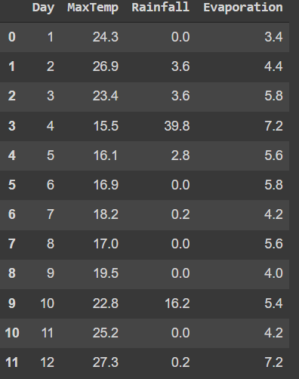
INTRODUCTION:
WHAT ARE WE DOING?
We wanted to check how methods of interpolation that were taught in this course would work on this abrupt data. Thus we have used four linear interpolation methods on certain data intervals and predicted values and checked their accuracy. The data used here is from the University of California, Irvine’s repository consisting of the weather data of Chicago in the year 1995. This data varies drastically and unpredictably; thus, we changed our approach and fit our models accordingly. We also used linear and logistic regression models of machine learning on the entire database and checked its accuracy.
WHY ARE WE DOING THIS?
Since the weather data is so erratic and turbulent, we wanted to see how we can apply the techniques taught to us during this course on this data. Furthermore we wanted to explore how machine learning which is commonly used to predict data would work on this erratic database.
Data set

Slide 5
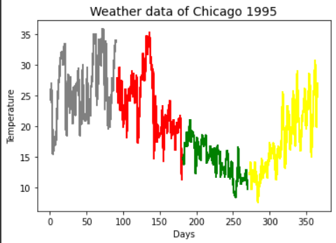
2. MATHEMATICAL MODEL:
2.1 Bifurcation of the dataset and obtaining points for analysis:
We imported a dataset from the University of California, Irvine’s
repository consisting of the weather data of Chicago in the year
1995. This entire data was plotted on a graph to get a basic idea of
the data trends. On plotting, we obtained a rather
irregular and unpredictable graph.
Thus, we decided to divide this data into quarterly segments each
representing the prevalent four seasons.
The points we got were:
[46, 109, 214, 308]
Using the intervals surrounding the point of concern, we will be using interpolation techniques like Newton’s method, Lagrange’s method, Cubic spline method and Least Square method for comparison and prediction.

Slide 6

2.2 Best Model to incorporate and predict the values based on different methods and intervals:
By using numerical methods of interpolation namely Newton’s method, Lagrange’s method, Cubic Spline method, and Least Squares method we will predict the values of these days using a varying input dataset. As the data corresponds to the weather of an area it is erratic in nature thus to predict a specific day, it is more sensible to choose an interval of inputs to get much better results.
2.3 Advancing to Machine Learning models:
In the aforementioned methods, we are able to take into account at
max one of the factors on which the weather of a place might
depend. Due to this, we observe great values of errors in prediction
with these models. Thus in accordance with today's used methods
of weather-forecasting which use a great deal of Machine Learning,
we incorporated this into our project. The Machine Learning model
would be more accurate as it takes into consideration the majority
of the factors and their respective contribution to the final result.
Notes:
\

Slide 7
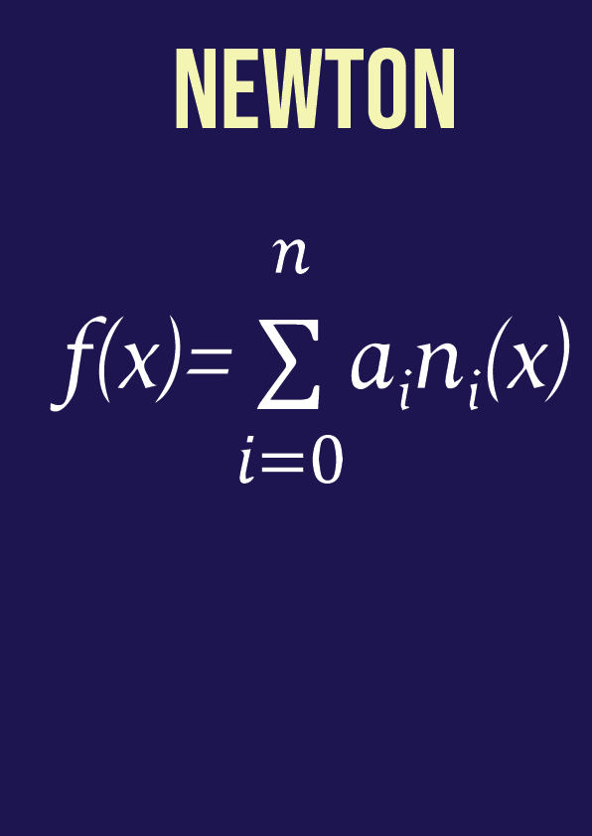
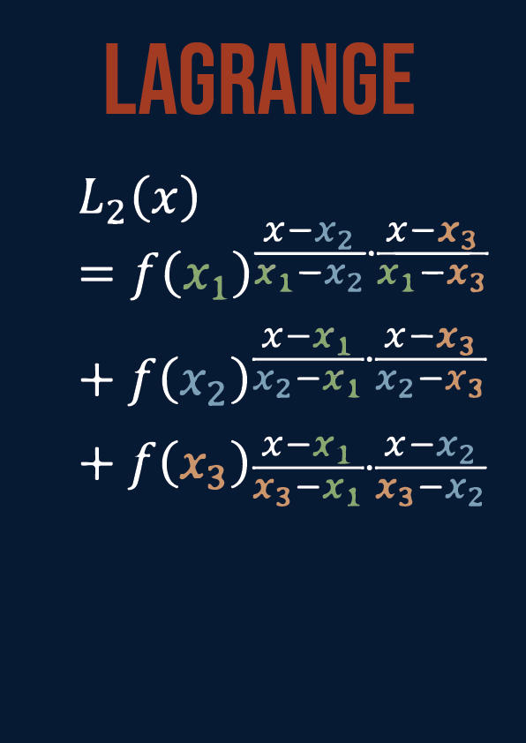
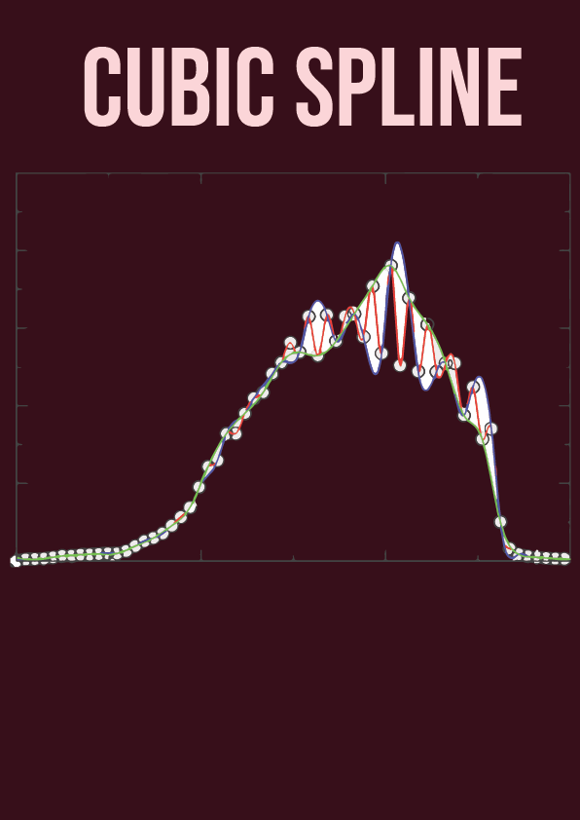
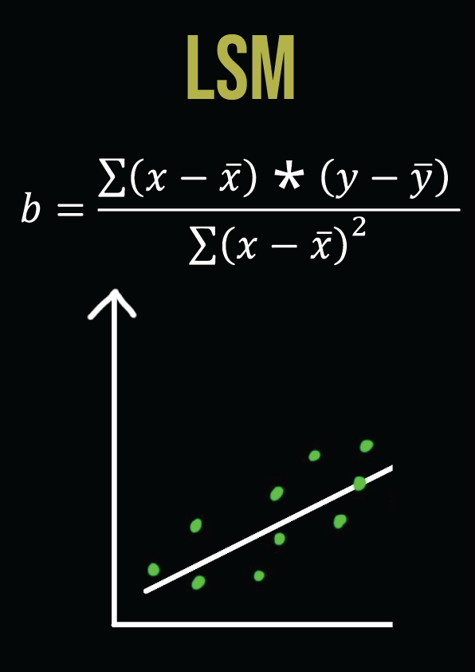
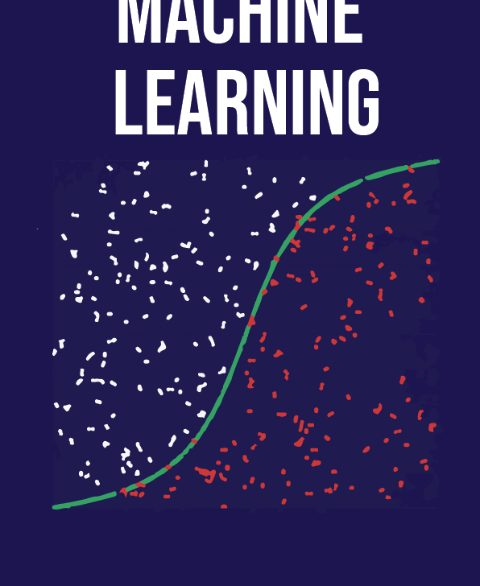
3. Numerical Analysis :
Methods used for interpolation:
NEWTON POLYNOMIAL INTERPOLATION
LAGRANGE INTERPOLATION METHOD
CUBIC SPLINE INTERPOLATION
LEAST SQUARE METHOD
MACHINE LEARNING
In newton’s polynomial we can determine the coefficients ai using the simple mathematical procedure. Since the polynomial goes through each data point, therefore for a data point (xi,yi), it’ll be f(xi)=yi, thus,
f(x0)= a0=y0
The Lagrange interpolation formula is a method for determining a polynomial, known as a Lagrange polynomial, that takes on specific values at random places. Lagrange's interpolation is a polynomial approximation to f(x) of Nth degree.
Cubic spline interpolation is a way of finding a curve that connects data points with a degree of three or less. Splines are polynomial that are smooth and continuous across a given plot and also continuous first and second derivatives where they join.
The least squares method is a statistical procedure to find the best fit for a set of data points by minimizing the sum of the offsets or residuals of points from the plotted curve.
Machine Learning models like Logistic Regression, Decision Tree Classifier, K Neighbors Classifier, Linear Discriminant Analysis, SVC, and GaussianNB were used to predict these values. This model was applied to the entire dataset and took into account factors like rainfall, temperature and humidity for the entire year to predict the same four values.

Slide 8
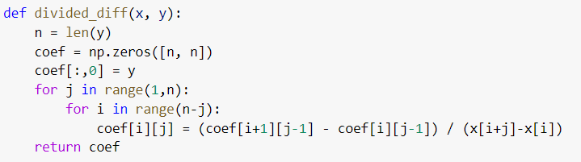
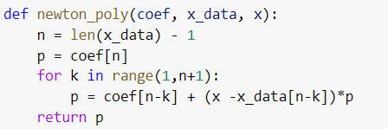
4. Algorithm and Python Code
4.1 Newton Interpolation :
-The primary approach in this method was to create a coefficient matrix of the divided differences. For this purpose, a top to down approach was followed, and each subsequent entry was computed recursively using the entry of the previous column.
-On the computation of this matrix, the polynomial was computed using another function in which a for loop was run and the temperature of the given day was calculated by inputting it in the polynomial computed using divided differences.

Slide 9
3. Numerical Analysis :
Methods used for interpolation:
NEWTON POLYNOMIAL INTERPOLATION
LAGRANGE INTERPOLATION METHOD
CUBIC SPLINE INTERPOLATION
LEAST SQUARE METHOD
MACHINE LEARNING
In newton’s polynomial we can determine the coefficients ai using the simple mathematical procedure. Since the polynomial goes through each data point, therefore for a data point (xi,yi), it’ll be f(xi)=yi, thus,
f(x0)= a0=y0
The Lagrange interpolation formula is a method for determining a polynomial, known as a Lagrange polynomial, that takes on specific values at random places. Lagrange's interpolation is a polynomial approximation to f(x) of Nth degree.
Cubic spline interpolation is a way of finding a curve that connects data points with a degree of three or less. Splines are polynomial that are smooth and continuous across a given plot and also continuous first and second derivatives where they join.
The least squares method is a statistical procedure to find the best fit for a set of data points by minimizing the sum of the offsets or residuals of points from the plotted curve.
Machine Learning models like Logistic Regression, Decision Tree Classifier, K Neighbors Classifier, Linear Discriminant Analysis, SVC, and GaussianNB were used to predict these values. This model was applied to the entire dataset and took into account factors like rainfall, temperature and humidity for the entire year to predict the same four values.

Slide 10
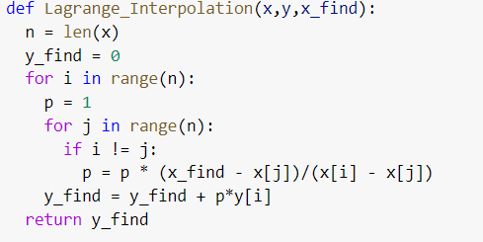
4. Algorithm and Python Code
4.2 Lagrange Interpolation:
This method involved running nested a loop for the square of the number of values run in the input data. After this for each iteration of the j loop wrt a single iteration in the i loop, the value of the polynomial was computed as a product of the interpolation at a given point. The value of the temperature was then computed for each polynomial value and added to in each subsequent iteration. Thus the error was minimized after n*n iterations.

Slide 11
3. Numerical Analysis :
Methods used for interpolation:
NEWTON POLYNOMIAL INTERPOLATION
LAGRANGE INTERPOLATION METHOD
CUBIC SPLINE INTERPOLATION
LEAST SQUARE METHOD
MACHINE LEARNING
In newton’s polynomial we can determine the coefficients ai using the simple mathematical procedure. Since the polynomial goes through each data point, therefore for a data point (xi,yi), it’ll be f(xi)=yi, thus,
f(x0)= a0=y0
The Lagrange interpolation formula is a method for determining a polynomial, known as a Lagrange polynomial, that takes on specific values at random places. Lagrange's interpolation is a polynomial approximation to f(x) of Nth degree.
Cubic spline interpolation is a way of finding a curve that connects data points with a degree of three or less. Splines are polynomial that are smooth and continuous across a given plot and also continuous first and second derivatives where they join.
The least squares method is a statistical procedure to find the best fit for a set of data points by minimizing the sum of the offsets or residuals of points from the plotted curve.
Machine Learning models like Logistic Regression, Decision Tree Classifier, K Neighbors Classifier, Linear Discriminant Analysis, SVC, and GaussianNB were used to predict these values. This model was applied to the entire dataset and took into account factors like rainfall, temperature and humidity for the entire year to predict the same four values.

Slide 12
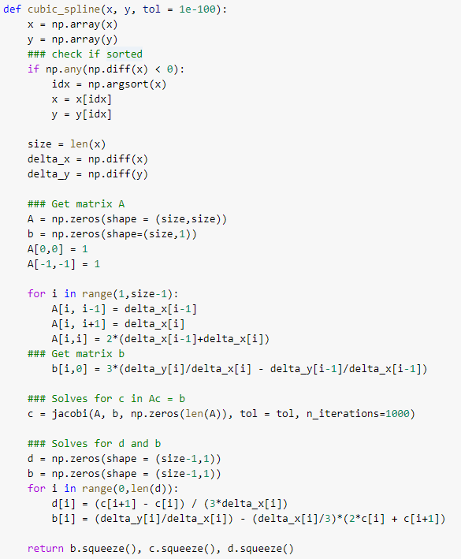
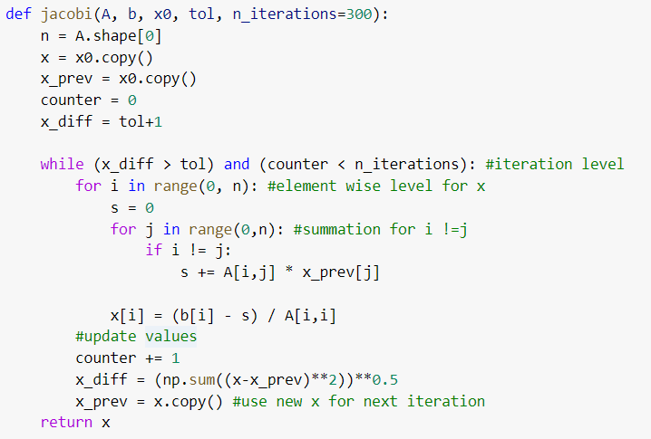
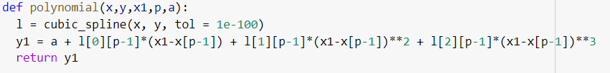
4. Algorithm and Python Code
4.3 Cubic Spline Interpolation:
To implement this model, the matrices A,B,C were first calculated which are the coefficient matrix of the polynomial. These matrix coefficients were computed by writing the boundary conditions and inverting the matrix to yield the result using the delta of the data
Set. When these matrices
were set in the Ax = b
form, they were sent to
be computed using the
Jacobian method.
The results of these
matrices were then
obtained and the
polynomial was written by
multiplying the coefficient
by the respective degree
term.

Slide 13
3. Numerical Analysis :
Methods used for interpolation:
NEWTON POLYNOMIAL INTERPOLATION
LAGRANGE INTERPOLATION METHOD
CUBIC SPLINE INTERPOLATION
LEAST SQUARE METHOD
MACHINE LEARNING
In newton’s polynomial we can determine the coefficients ai using the simple mathematical procedure. Since the polynomial goes through each data point, therefore for a data point (xi,yi), it’ll be f(xi)=yi, thus,
f(x0)= a0=y0
The Lagrange interpolation formula is a method for determining a polynomial, known as a Lagrange polynomial, that takes on specific values at random places. Lagrange's interpolation is a polynomial approximation to f(x) of Nth degree.
Cubic spline interpolation is a way of finding a curve that connects data points with a degree of three or less. Splines are polynomial that are smooth and continuous across a given plot and also continuous first and second derivatives where they join.
The least squares method is a statistical procedure to find the best fit for a set of data points by minimizing the sum of the offsets or residuals of points from the plotted curve.
Machine Learning models like Logistic Regression, Decision Tree Classifier, K Neighbors Classifier, Linear Discriminant Analysis, SVC, and GaussianNB were used to predict these values. This model was applied to the entire dataset and took into account factors like rainfall, temperature and humidity for the entire year to predict the same four values.

Slide 14
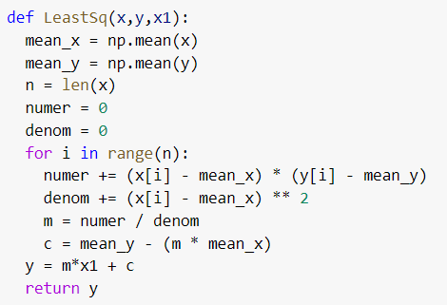
4. Algorithm and Python Code
4.4 Least Square Fitting:
For this method, the slope of the line was calculated as the product of the difference from the mean for both x and y, which was divided by the square of the difference between the mean and x. The value of the Temperature for the day was then calculated using the obtained slope and intercept.

Slide 15
3. Numerical Analysis :
Methods used for interpolation:
NEWTON POLYNOMIAL INTERPOLATION
LAGRANGE INTERPOLATION METHOD
CUBIC SPLINE INTERPOLATION
LEAST SQUARE METHOD
MACHINE LEARNING
In newton’s polynomial we can determine the coefficients ai using the simple mathematical procedure. Since the polynomial goes through each data point, therefore for a data point (xi,yi), it’ll be f(xi)=yi, thus,
f(x0)= a0=y0
The Lagrange interpolation formula is a method for determining a polynomial, known as a Lagrange polynomial, that takes on specific values at random places. Lagrange's interpolation is a polynomial approximation to f(x) of Nth degree.
Cubic spline interpolation is a way of finding a curve that connects data points with a degree of three or less. Splines are polynomial that are smooth and continuous across a given plot and also continuous first and second derivatives where they join.
The least squares method is a statistical procedure to find the best fit for a set of data points by minimizing the sum of the offsets or residuals of points from the plotted curve.
Machine Learning models like Logistic Regression, Decision Tree Classifier, K Neighbors Classifier, Linear Discriminant Analysis, SVC, and GaussianNB were used to predict these values. This model was applied to the entire dataset and took into account factors like rainfall, temperature and humidity for the entire year to predict the same four values.

Slide 16
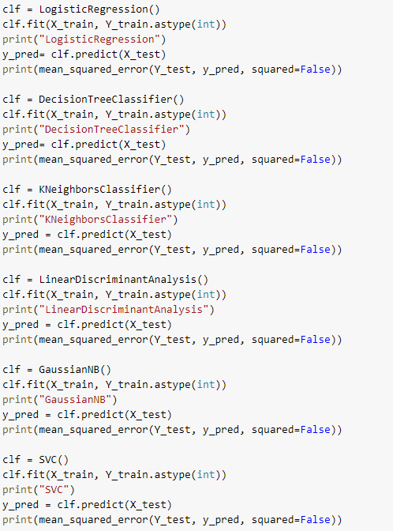
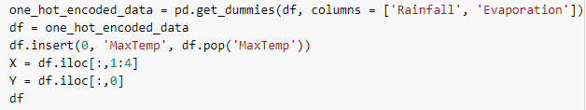
4. Algorithm and Python Code
4.5 Machine Learning Implementation:
The data was one hot encoded in the Rainfall and Humidity columns,
this data was then run in popular machine learning models,
and their RMSE was computed.

Slide 17
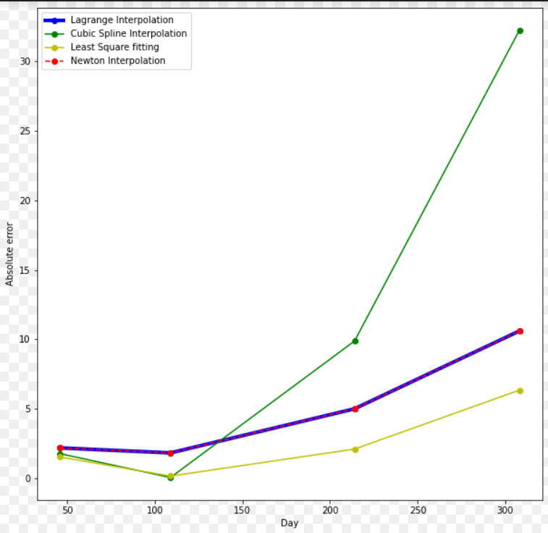
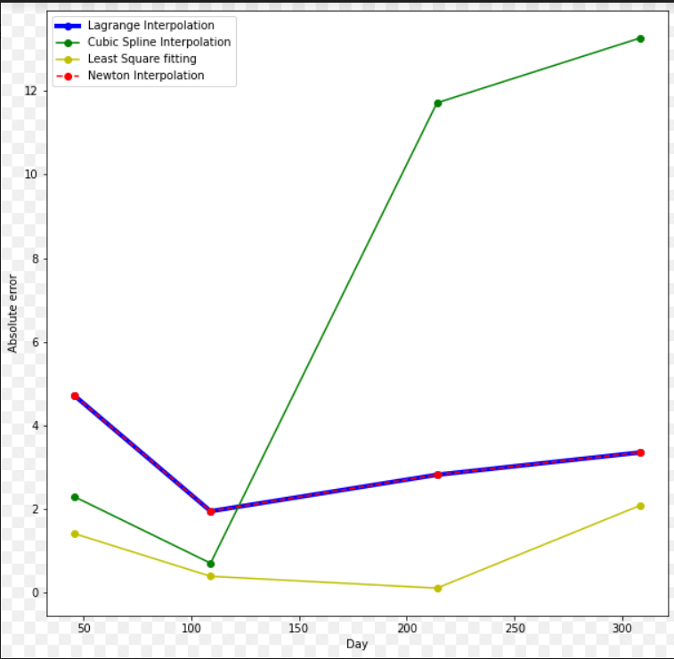
5. Results and Discussion
5.1 Error Analysis
.
4 day interval
7 day interval

Slide 18
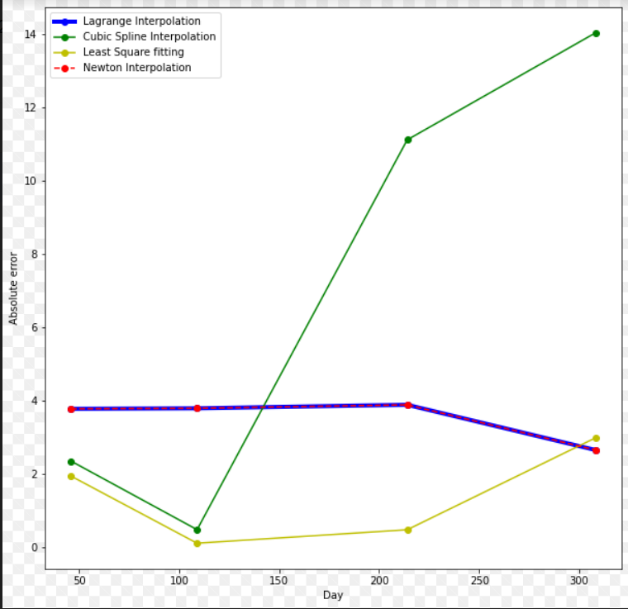
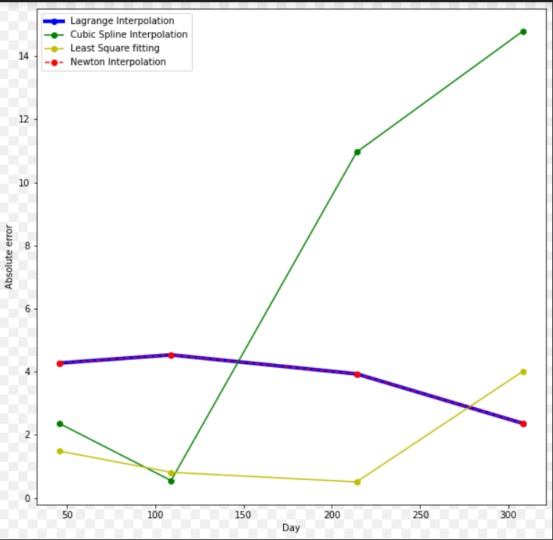
5. Results and Discussion
5.1 Error Analysis
.
10 day interval
15 day interval

Slide 19
5. Results and Discussion
5.2 RMSE : Different numerical methods.
Method | 4-day interval | 7-day interval | 10-day interval | 14-day interval
Newton Interpolation | 15.623239900865638 | 9.25665207889713 | 9.374716099673819 | 6.986638949359213
Lagrange Interpolation | 15.623239900865629 | 9.25665207889713 | 9.374716099673826 | 6.986638949359211
Cubic Spline Interpolation | 27.56979532326306 | 50.41442592842062 | 52.19874928468699 | 52.121808484764685
Least Squares Fitting | 2.4341765411887177 | 2.0989710269994846 | 2.859426736855427 | 3.464424463129617

Slide 20
5. Results and Discussion
5.2 RMSE :
Method | RMSE
Logistic Regression | 6.025407914866888
DecisionTreeClassifier | 3.6495279220817114
K Neighbors Classifier | 4.450341620655715
Linear Discriminant Analysis | 5.611775746323709
SVC | 5.531983174037846
Gaussian NB | 6.896150512560751

Slide 21
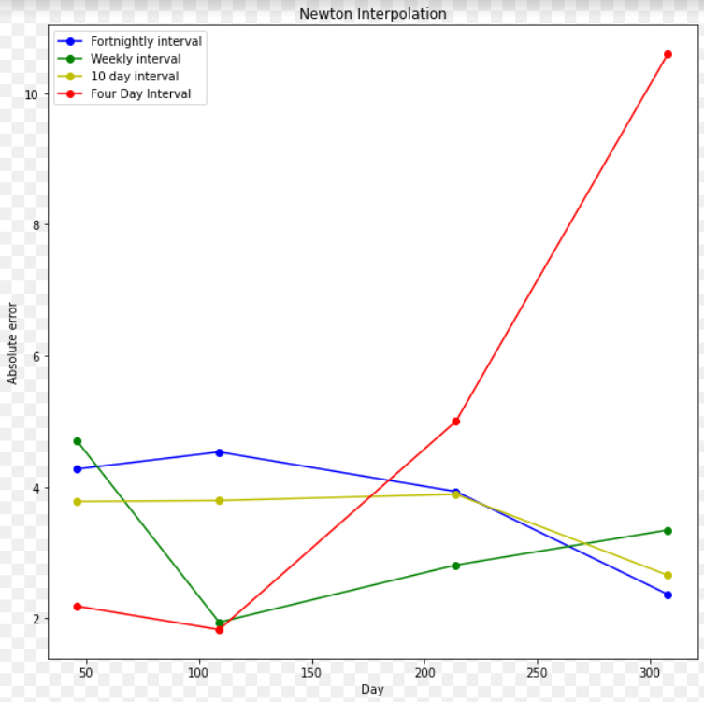
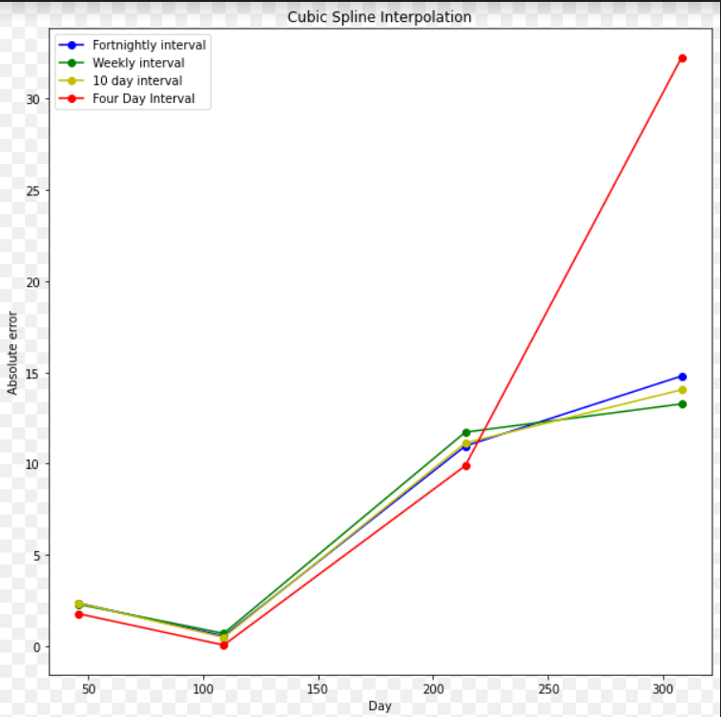
5. Results and Discussion
5.3 Errors in different methods for different intervals:
Newton interpolation
Cubic Spline interpolation

Slide 22
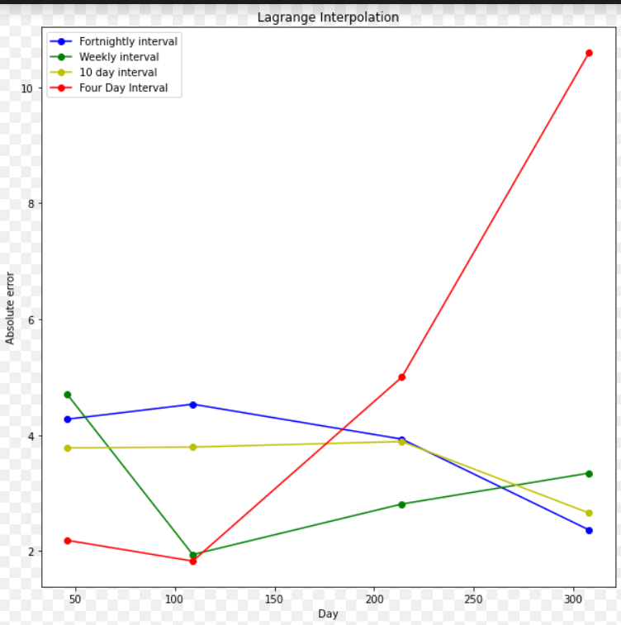
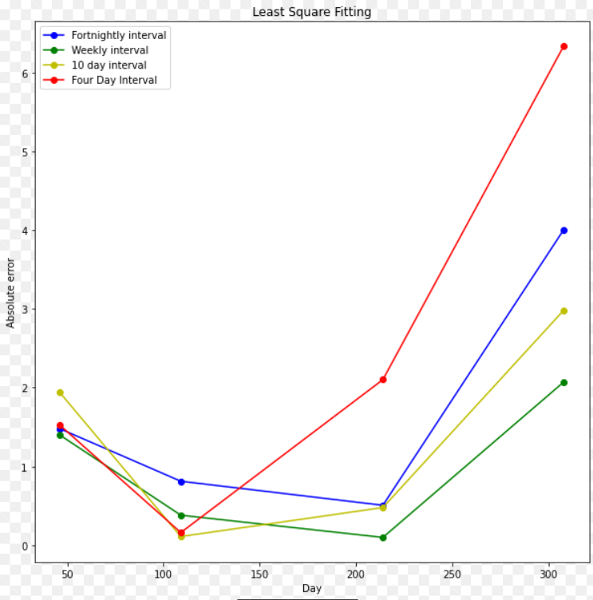
5. Results and Discussion
5.3 Errors in different methods for different intervals:
Lagrange interpolation
Least Square fitting

Slide 23
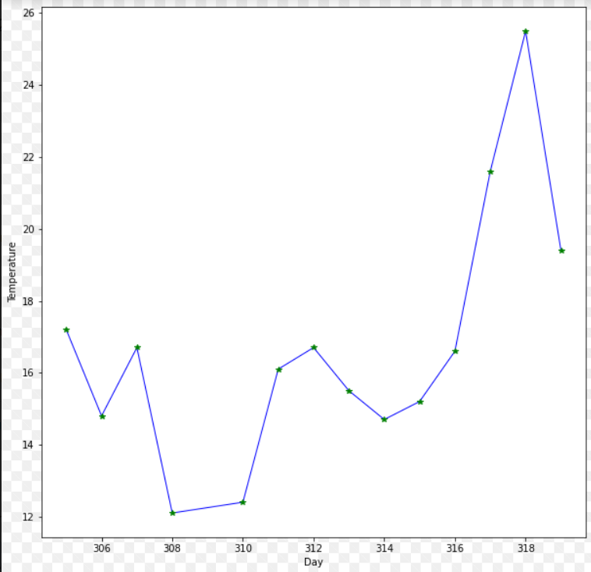

5. Results and Discussion
5.4 Polynomial Analysis:
The polynomial we obtained by using Newton Method looks like this because in the Newton method we predict the values in between the two points by connecting them with lines.
The polynomial we obtained by using Lagrange Method looks like this because in the Lagrange method we predict the values between the two points by connecting them with lines.

Slide 24
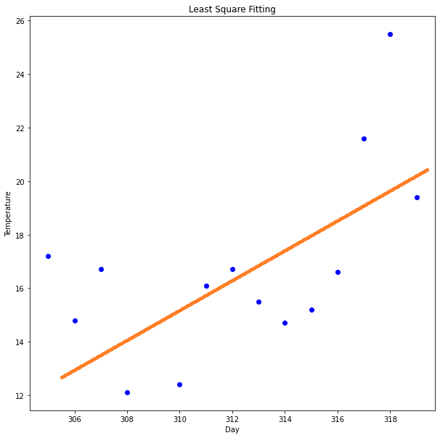
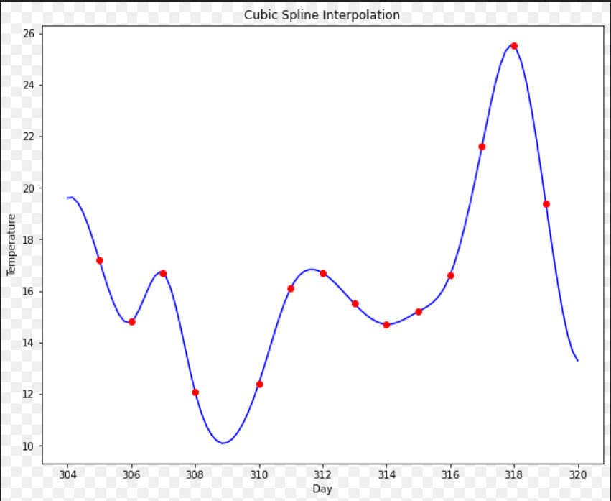
5. Results and Discussion
5.4 Polynomial Analysis:
The polynomial we obtained by using a Cubic spline looks like this because in this we join two points by a cubic function. At the ends, the first and second derivatives of the function are also along with its value.
The graph that we obtained while performing the Least square method looks like this because in it the square of the distances of all the points from a single line is minimum. Which in this case is the orange line.

Slide 25
6. CONCLUSION:
The maximum error was in the cubic spline method and the least in the least square method. This is major because the data inputted wasn’t linear rather was very irregular thus, led to a huge error in cubic spline which is mostly used for non-linear inputs.
We also obtained polynomial graphs for each of the methods for the entire year and they followed their basic principles. The graph for Newton’s and Lagrange had points linearly connected while the cubic spline method connected points with cubical functions and the least square method predicted the best fit curve for the data.

Slide 26
6. CONCLUSION
The error obtained via the Machine Learning model is greater than the least square methods. This is because we have applied the Machine learning model to the entire data set of 365 days while the least square method and other interpolation methods are applied to a set of data ranging from four to fourteen days. Thus, in the long run, the Machine Learning model will provide more accurate results thus, it’s used extensively for weather-forecasting purposes due to its ability to take all factors into consideration simultaneously.
On changing the intervals of consideration we expected to see less error with an increasing set of input. This is observed to some extent in Newton’s and Lagrange’s method, but as we are dealing with data on weather it is not only erratic and unpredictable but also varies on various factors that the linear interpolation doesn't take into account.

